Slide 1

Car Showroom Sales Management System
This presentation will guide you through the features and functionalities of the Car Showroom Sales Management System. This system aims to simplify and automate showroom by tracking sales, profits, taxes, and expenses. It aims to make the showroom operations more efficient and organized

Slide 2
Concepts using in project
1
Arrays
2
Functions
Store car models, prices, and units sold for each company.
Display cars, modify prices, enter sales data, track expenses.
3
File Handling
4
Loops
Save and load data using input/output file streams (fstream).
Profit For display information, recording monthly sales, calculating profit and tax

Slide 3
System Functionality
View Available Cars
Modify Car Prices
Displays a list of cars for each company with their prices.
Allows the user to modify the price of a selected car model.
Enter Monthly Sales
Calculate Profits & Taxes
Collects sales data for each car model by company for a given month.
Calculates profit and tax based on sales data and pre-defined rates.
View Monthly Expenses
Calculate Net Profit
Allows the user to enter monthly expenses like rent and salaries.
Determines the net profit by subtracting total expenses from total profits.

Slide 4
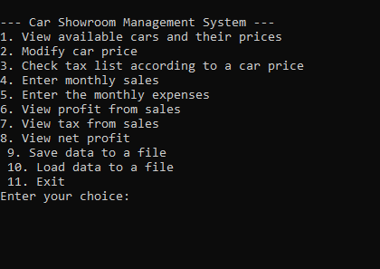
Program Workflow
1
Main Menu Interaction
The user in presented with simple menu to choose from the actions like view cars, entering sales, calculating profit etc.
2
Data Flow
Data is first entered through user input for sales and expenses then it is processed to calculate profits and tax
3
Reports Generated
The stored data is analyzed to generate reports, including sales profit calculations, tax calculations and net profit calculations

Slide 5





Benefits of Using the System
Enhanced Efficiency
Automates repetitive tasks, saving time and effort for showroom staff.
Improved Accuracy
Reduces human errors in data entry and calculations, ensuring accurate financial reporting.
Better Decision Making
Provides valuable insights into sales trends, expenses, and profitability, aiding in informed decision-making.
Streamlined Operations
Simplifies showroom operations, making it easier to manage sales, profit, and expenses.

